Slide 1


Homelessness Innovation Fund (HIF)
Information session
Rebecca Pinkstone
CEO, Homes NSW
11 September 2024

Slide 2
Acknowledgement of Country
I acknowledge the Traditional Custodians of the various lands on which we work today and the Aboriginal and Torres Strait Islander people participating in this meeting/webinar.
I pay my respects to Elders past, present and emerging, and recognise and celebrate the diversity of Aboriginal peoples and their ongoing cultures and connections to the lands and waters of NSW.

Slide 3
Questions are encouraged!
Cameras and microphones have been disabled
Any questions, please email: shsprogram@homes.nsw.gov.au

Slide 4
Today’s session
Introduction to the Homelessness Innovation Fund (HIF)
Overview of the two HIF grant programs:
Reforming Temporary Accommodation
Service Reform and Innovation
Timelines
Submitting a grant application
Further information

Slide 5



Slide 6
Introduction to the HIF
Of the $527.6 million allocated in the 2024/25 NSW Budget for frontline homelessness services (over 4 years),
$100M has been earmarked to establish the Homelessness Innovation Fund (HIF).
The intent of the HIF is to enable and support service innovation to better respond to the current crisis and begin moving us towards system transformation.
The HIF has two grant programs:
Reforming Temporary Accommodation (RTA)
Service Reform and Innovation (SRI)
$30M has been provisionally allocated for 2024/25.

Slide 7
Eligibility criteria for HIF grant programs
Which organisations are eligible?*
All accredited Specialist Homelessness Services (SHS)
All registered Community Housing Providers (CHPs) and Aboriginal Community Housing Providers (ACHPs), both through National or Local Schemes
Consideration will be given to other organisations who agree to achieve SHS accreditation and housing providers who are in the process of registration
Partnerships are welcome
Applications led by, or in partnership with Aboriginal-led providers will be highly regarded
*Full eligibility criteria (including regulatory, insurance etc) outlined in Program Guidelines

Slide 8
Overview of the two HIF grant programs
Reforming Temporary Accommodation (RTA)
Service Reform and Innovation (SRI)

Slide 9
Grant Program : Reforming Temporary Accommodation
1

Slide 10

Why focus on TA?
Demand has increased markedly:
In 2023/24 the number of households utilising TA increased by 14%
The length of stay in TA increased by 121% to an average of 27 nights in the same period.
Many people are staying in TA without access to support or facilitated housing outcomes.
People are cycling back into homelessness from TA - about one third of households in TA in 2023/24 had utilised TA in the previous year.

Slide 11

Reforming TA: Program objectives
Reduce the cost, use and length of stay
Move away from commercial hotels and motels
Increase access to appropriate supports
Encourage flexible and sustainable use of properties and support services
Attract co-contributions from the sector

Slide 12
Reforming TA: Scale of grants available
Grant scale and conditions
The maximum amount that will be considered is $500,000 per application, except in exceptional circumstances.
Some proposals may be funded by other mechanisms and processes where it makes sense to do that – the HIF is the vehicle to bring ideas forward.
Funding will need to be spent within
12 months of an executed Grant Funding Agreement.
Options for proposals
Providers could model their proposal based on a nightly room rate when a temporary accommodation client is placed in the service*.
Or, providers could request a lump sum, based on proposed capital works or other up-front costs.
Any proposed per night charge should be significantly less than comparable commercial motel/hotel rates.
Services will not be paid when there are no clients occupying rooms, but Homes NSW will undertake to fill sector-supported TA before commercial options.

Slide 13
Reforming TA: Service requirements
Grant proposals need to describe:
The basics of the operational model, including which property they will use, how many TA rooms it will have, the per-night charge, the intake and support hours they will provide and the groups of people they will accommodate.
The organisation’s capacity to provide support to clients and to actively assist them into long term housing options.
The amenity and appropriateness of the property, eg age, access to kitchen and bathroom facilities (self-contained preferred) and proximity to public transport and other community facilities.
How quickly the model can be operational.
How the model/property can be transitioned in future to provide longer term housing models as demand for TA reduces.

Slide 14
Reforming TA: Assessment criteria
Value for money.
How the model will reduce demand for TA through the level and quality of the supports offered, service integration/co-ordination and the pathways out of TA.
How the model will reduce the nightly cost of TA noting the cost charged should be significantly less than market rates charged by commercial operators in the area.
The type and value of co-contributions and how the model responds to particular cohorts or regional factors.
The amenity of the property or properties.
How long properties are available for if lease or access is ‘meanwhile’ or term-limited.
The level and quality of the support services that will be provided.
The viability of the model based on current demand for temporary accommodation, as well as sustainability of the model over time when demand decreases.

Slide 15
Grant Program: Service Reform and Innovation
2

Slide 16

Why focus on service reform and innovation?
Homes NSW is often approached by organisations with great ideas to improve the homelessness system.
We wanted to create a mechanism for these ideas to be considered in an open and transparent process.
Grant program purpose
Support homelessness services to transform current accommodation and/or service responses to deliver more and/or better outcomes for clients.
Support homelessness services in action-research to test new service delivery approaches.
Increase the flexibility of assets and/or supports so they can adapt to changing need and demand for services and housing.

Slide 17

Service Reform and Innovation: Examples
This is a deliberately flexible program. Examples of initiatives that could be considered include:
Using meanwhile use properties to increase the supply of medium-term accommodation for people with less complex needs.
Reconfiguring existing crisis or transitional accommodation to accommodate more clients, or to improve outcomes for clients.
Flexible outreach supports for clients with complex needs (including those staying in motels and those newly housed who require support to sustain their tenancy).
More Aboriginal services.
Mainstream / non-Aboriginal services improving the cultural safety of their services and accommodation.
New or improved responses for specific cohorts – such as children and young people, families, or women and children leaving violence.
Improved triaging and support co-ordination responses.
An initial smaller grant to develop a prototype service model or transformation proposal that underpins a larger grant request in later rounds of the HIF.

Slide 18
Service Reform and Innovation
Scale and conditions of grant funding:
There is no specific limit on the value of the grant providers can apply for.
The intention is to achieve a statewide impact, so proposals will be assessed with the intention of sharing impact across a range of regions.
Funding through the HIF will need to be spent within 12 months.
Homes NSW may vary the distribution of funds depending on the number
of funding applications submitted.
Homes NSW may also offer successful applicants a package lower than
the amount requested.

Slide 19
Service Reform and Innovation:
Assessment criteria
Value for money.
How the project proposal will provide accommodation for more clients within exiting support resources. This includes crisis and medium-term accommodation.
How the project proposal will support people out of crisis accommodation and into more stable and appropriate accommodation.
How the project proposal will reach more clients and/or deliver better outcomes for clients.
How the project proposal will improve the coordination of service delivery.
How the model responds to particular cohorts, or regional factors.
Evidence that the applicant has the capacity and capability to execute the proposal and within the proposed timeframes.
How the model reshapes service delivery or contributes to system transformation.

Slide 20
Application timelines
Both HIF Grant Programs open on 11 September 2024 and remain open until 30 April 2025.
Assessment of applications will be incremental, as follows:
Submitted applications received by 30 October 2024 will be assessed and announced in November 2024.
Submitted applications received by 14 February 2025 will be assessed and announced in March 2025.
Organisations can submit an application at any time within that period.
Submitted applications received by 30 April 2025 will be assessed and announced in May 2025.

Slide 21
Submitting a Grant Application:
All grant programs fall under the NSW Grant Administration Guide
Both Grant programs as an Open Competitive processes
Grant applications will be assessed against the assessment criteria so please ensure that you address these for each program separately.
Use the resources and supporting documents that are listed on the DCJ Grants Page

Slide 22
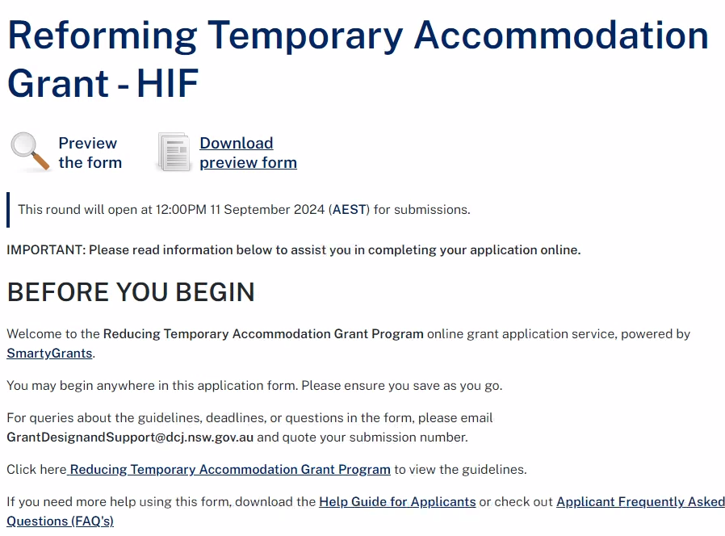
How to apply
Eligible organisations are
invited to apply through a one-step application process using SmartyGrants via: DCJ Grants – Service Provider page https://dcj.nsw.gov.au/service-providers/grants.html
Web pages:
Service Reform and Innovation Grant
Reforming Temporary Accommodation Grant

Slide 23


Joint application (Subcontracting)
We will only award a grant to a single eligible organisation
Organisations can work together through one lead organisation using
subcontracting arrangements between them.
For example, an un-incorporated
community organisation can be a project partner of an eligible organisation.
For more information about Subcontracting please refer to the Grant Program FAQs, and DCJ Subcontracting Policy.

Slide 24
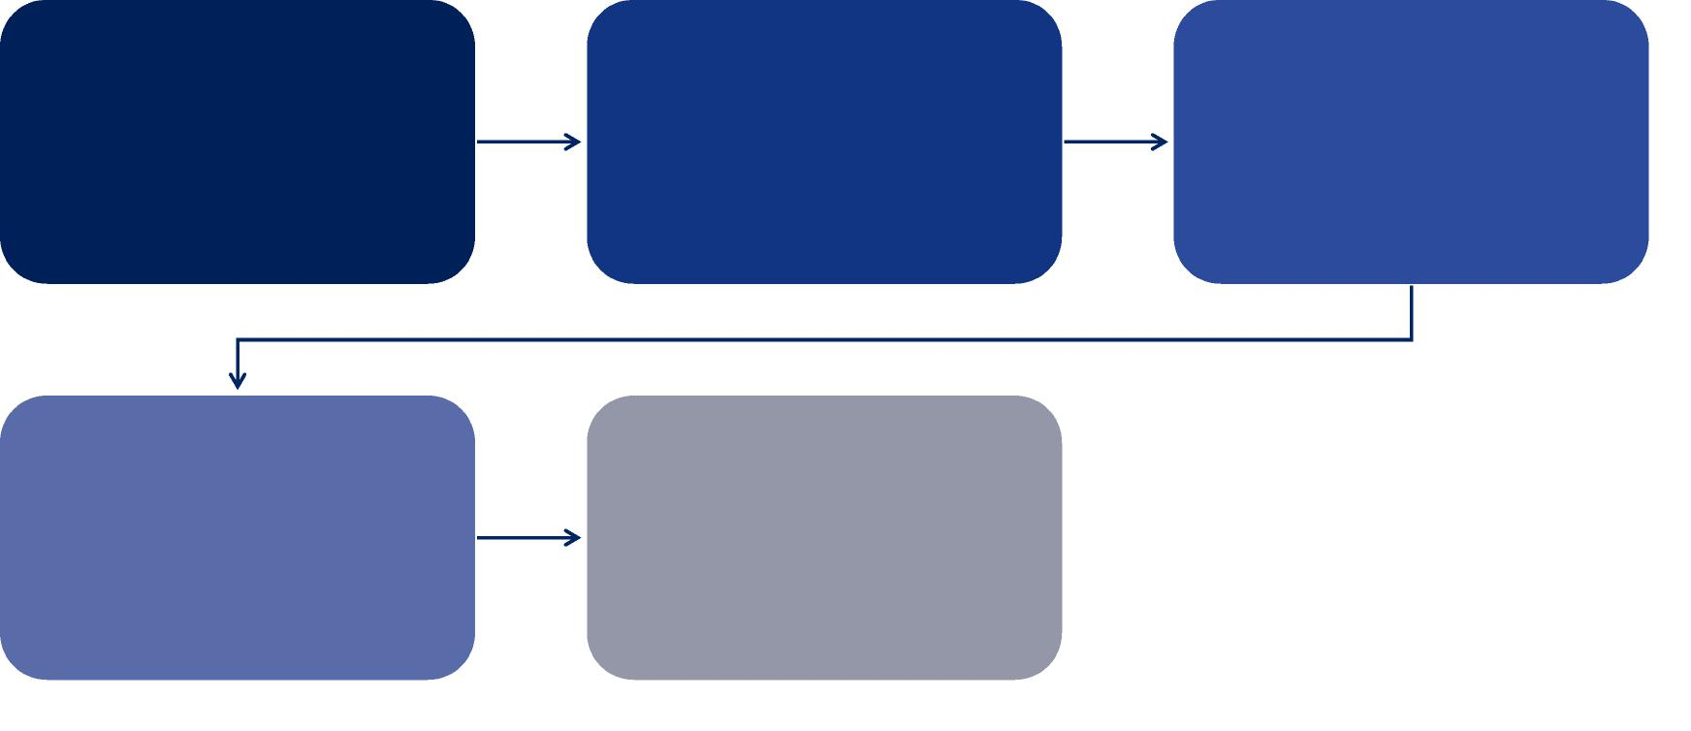
Assessment process
  Grant applications will be assessed against eligibility and assessment
  criteria, and program prioritisation.
All applications are
initially reviewed to
ensure compliance with
eligibility criteria and
required documentation
Eligible applications are
then assessed by independent assessors
Recommendations are sent to the assessment panel for review
The assessment panel will make recommendations for successful applications
The delegated decision-maker will consider the panel’s recommendations and make a final decision
Applicants will be notified of the outcome of their application

Slide 25



For further information and before you start your application, please review:
Grant Program Guidelines
Frequently Asked Questions (FAQs).
For program enquiries contact shsprogram@homes.nsw.gov.au
Apply by submitting you application through SmartyGrants portal
20

