Slide 1

Primary Prevention Multi-Year Partnership Grant Program
Primary Prevention
Women, Family and Community Safety
Information Session
Monday 16 December

Slide 2
Acknowledgment of Country
I would like to acknowledge the traditional
custodians of the lands we are all meeting on today.
I pay my respects to Elders past, present and emerging and celebrate the diversity of Aboriginal peoples and their ongoing cultures and connections to the lands and waters of NSW.
I also acknowledge and pay my respects to Aboriginal and Torres Strait Islander people joining us today.

Slide 3
Please turn your camera off and mute your microphone.
Post your questions in the chat.
There will be an opportunity to ask questions at the end of this presentation.
Any unanswered in-session questions will be taken on notice, and the answers will be shared with all stakeholders and included in our Grant FAQ document on the DCJ Grant website.

Slide 4
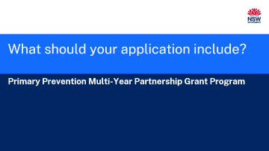
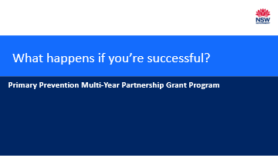
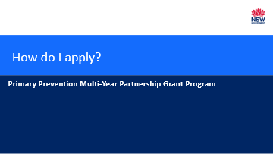
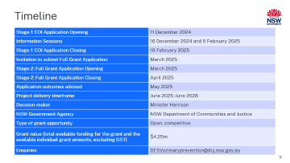
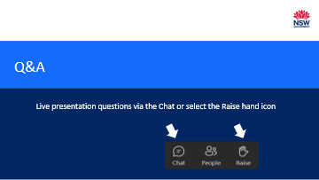
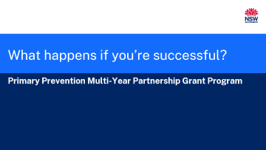
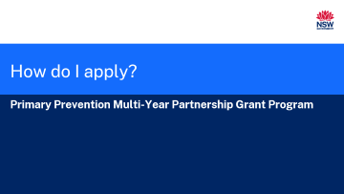
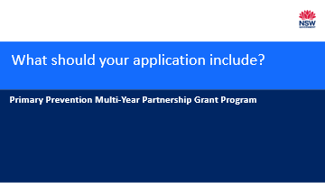
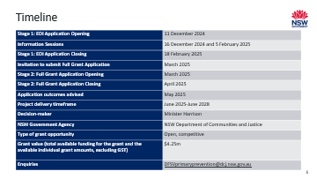
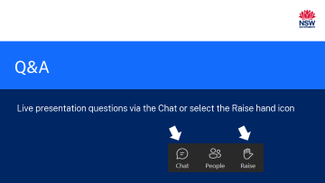
What we will cover today

Slide 5
Timeline
Stage 1: EOI Application Opening | 11 December 2024
Information Sessions | 16 December 2024 and 5 February 2025
Stage 1: EOI Application Closing | 18 February 2025
Invitation to submit Full Grant Application | March 2025
Stage 2: Full Grant Application Opening | March 2025
Stage 2: Full Grant Application Closing | April 2025
Application outcomes advised | May 2025
Project delivery timeframe | June 2025-June 2028
Decision-maker | Minister Harrison
NSW Government Agency | NSW Department of Communities and Justice
Type of grant opportunity | Open, competitive
Grant value (total available funding for the grant and the available individual grant amounts, excluding GST) | $4.25m
Enquiries | DFSVprimaryprevention@dcj.nsw.gov.au

Slide 6
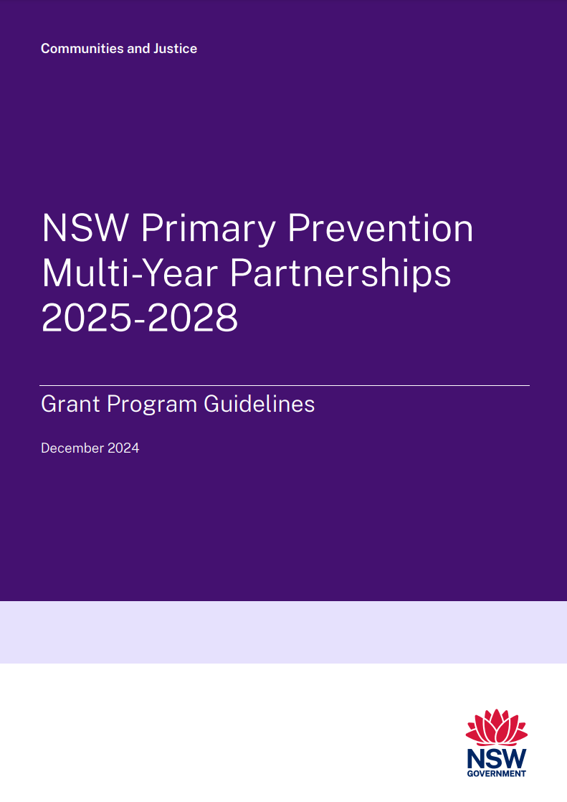
MYP Grant Program Guidelines
https://dcj.nsw.gov.au/documents/service-providers/grants/primary-prevention-multi-year-partnership-grant-program-guidelines.pdf

Slide 7
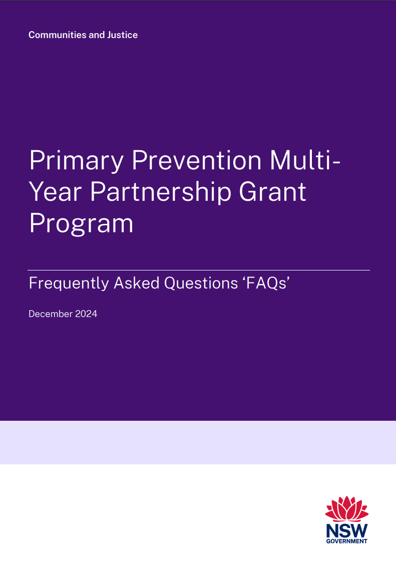
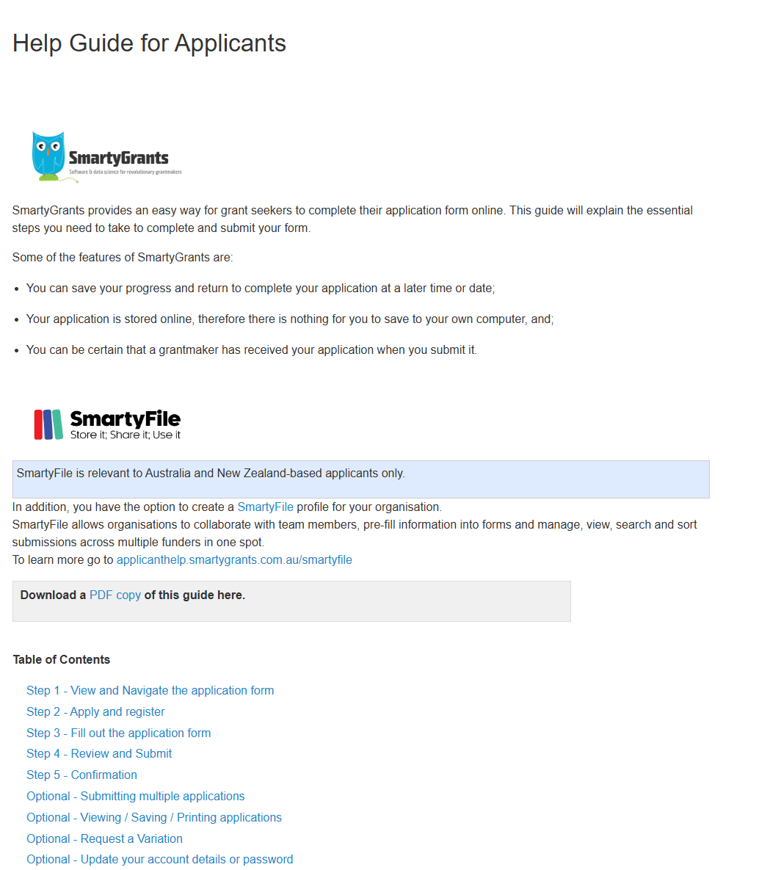
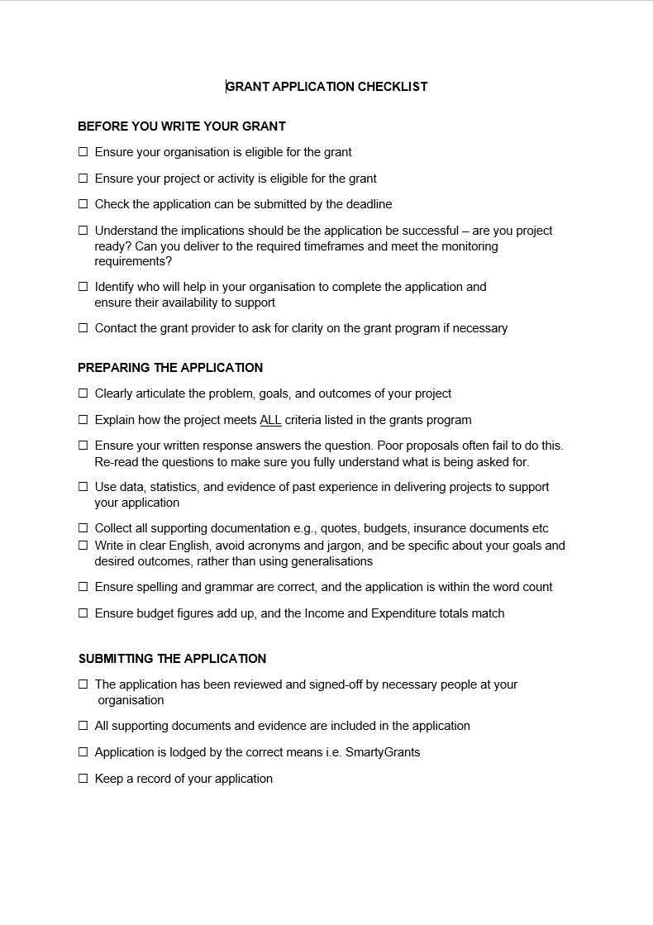
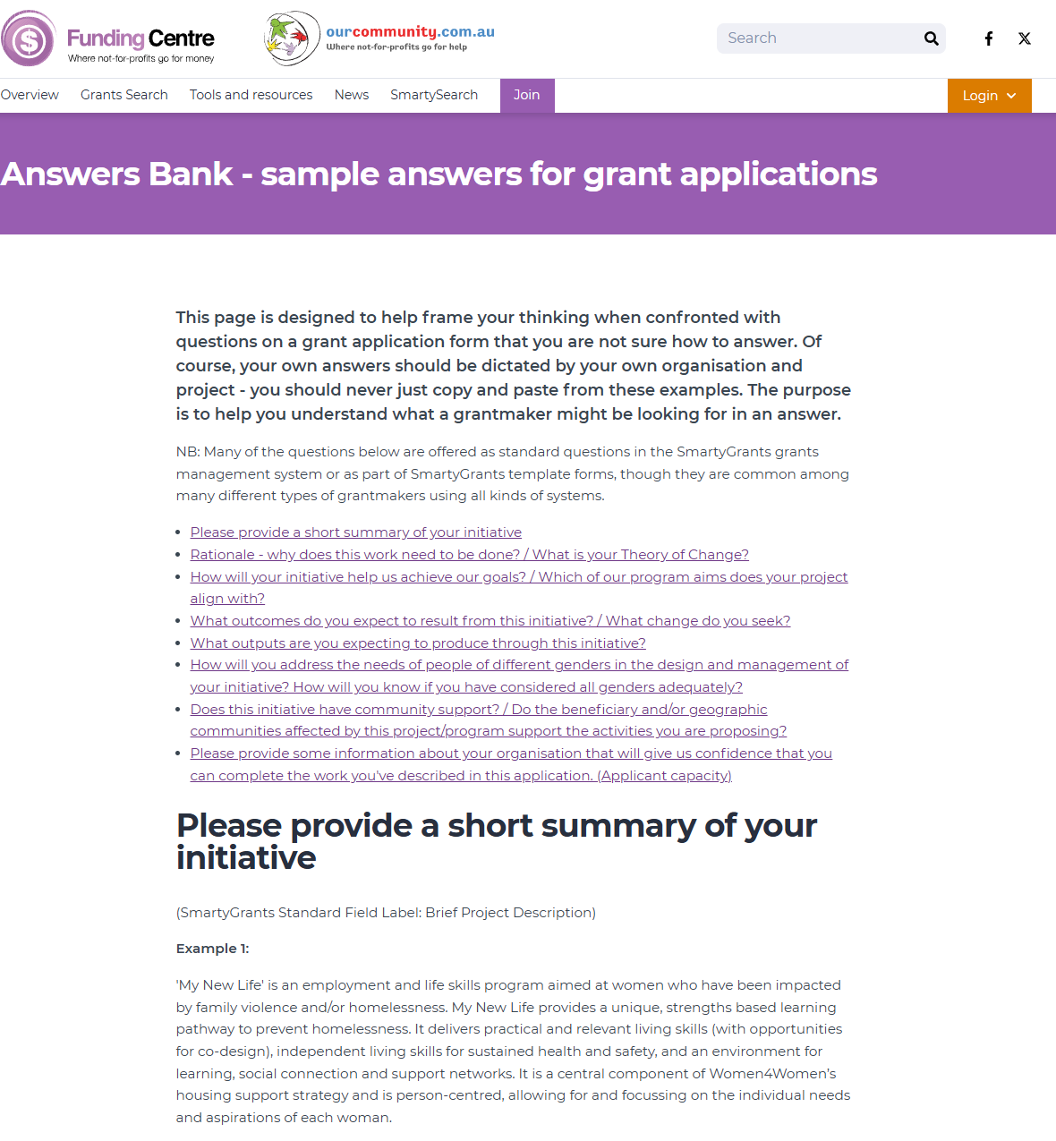
MYP Grant Program other resources
https://dcj.nsw.gov.au/service-providers/grants/grants-open/nsw-primary-prevention-multi-year-partnerships-grant-program.html

Slide 8
How do I apply?
Primary Prevention Multi-Year Partnership Grant Program

Slide 9



Are you eligible?
Eligible
Not eligible
Local government organisations
Aboriginal Community Controlled Organisation (ACCO) – these Applicants will be required to provide documentation to support their ACCO status
Incorporated organisation registered and approved as a not-for-profit body by NSW Fair Trading.
An individual.
Federal and State Government agencies and bodies.
NSW educational facilities (public schools, private schools, universities TAFE).
For-profit organisations, including Aboriginal owned businesses.
Unincorporated organisations or groups without an eligible subcontracting organisation.
7

Slide 10
Application Process – Two-Stage Approach
Stage 1 Grant applications open on Tuesday December 10 and close at 5pm (AEDT) on Tuesday 18 February.
The closing date and time is a strict deadline. No extensions will be permitted.
Eligible organisations are invited to apply through a Stage 2 application process using SmartyGrants (link to be provided to successful applicants)

Slide 11
All applications are initially reviewed to ensure compliance with eligibility criteria and requires documentation
Eligible applications are then assessed by independent assessors
Recommendations are sent to the assessment panel for review
Assessment Process – Stage 2
The assessment panel will make recommendations for grant funding
The delegated decision-maker will consider the panel’s recommendations and make a final decision
Applicants will be notified of the outcome of their application

Slide 12
Tips
You will receive an auto-generated email with your Application ID, application (PDF) and contact details for queries, upon submission of your application.
You may ‘save as you go’ as you fill out the form.
If you have already submitted your application, but wish to make changes/ amendments (prior to closing date), email the Grants Team at: GrantDesignandSupport@dcj.nsw.gov.au

Slide 13
What should your application include?
Primary Prevention Multi-Year Partnership Grant Program

Slide 14
Objectives and Expected Outcomes
Expanding existing programs that deliver primary prevention of family, domestic, or sexual violence.
Building further evidence on the effectiveness of established primary prevention approaches and their impact on reducing gender-based violence.
Developing strategic approaches to prevent gender-based violence while enhancing existing organisational capabilities.
Your application should address how your proposed project addresses the grant objectives and expected outcomes

Slide 15
Applications must address the grant program criteria
Cultural and Attitudinal Shifts
Sustainable Prevention Infrastructure
Capacity Building within Organisations
Building a Strong Evidence Base
Alignment with Strategic Goals
Positive changes in attitudes, norms, and practices that challenge gender stereotypes, promote gender equality, and reject violence.
A well-coordinated primary prevention network across NSW, fostering effective collaboration among councils, community organisations, and stakeholders.
Strengthened organisational capabilities to deliver impactful, scalable, and sustainable primary prevention programs.
Collection of robust and useful data to evaluate what works in primary prevention, supporting the refinement and evolution of prevention initiatives for long-term impact.
Clear alignment with Pathways to Prevention: NSW Strategy for the Prevention of Domestic, Family, and Sexual Violence 2024-2028, supporting its vision and objectives.

Slide 16

Insurance
Grant recipients must maintain current and adequate insurance appropriate to the activities/services funded under this grant to cover any liability of the grant recipient that might arise in connection with the performance of its obligations under a Grant Funding Agreement. This must include a minimum of $10 million Public Liability Insurance.
Applicants will be asked to provide a copy of all relevant insurance policies and certificates in the application form.
If your organisation is not covered by the appropriate insurance, you will need to approach another organisation (such as your local council or an incorporated not-for-profit) to sponsor your application so that your project will be covered under their insurance.
14

Slide 17

Joint application (Subcontracting)
Organisations can work together through one lead organisation using subcontracting arrangements between them.
For example, an un-incorporated community organisation can be a project partner of an eligible organisation.
For more information about Subcontracting please refer to the Grant Program FAQs, and DCJ Subcontracting Policy.

Slide 18
What happens if you’re successful?
Primary Prevention Multi-Year Partnership Grant Program

Slide 19
Successful Applicants – Grant Funding Agreement
The application, Grant Funding Agreement and acquittal for the grant will be managed using SmartyGrants and DocuSign.
Once we receive your signed Grant Funding Agreement, DCJ will countersign the agreement and return an executed copy of the agreement for your records to you by email.
Any variations to the Grant Funding Agreement must be formally requested and
approved in writing.
Failure to do so may result in the withdrawal of the grant offer.
Successful applicants will receive electronically via DocuSign a grant funding agreement and are required to sign and return it within two weeks of receipt.
Agreements can only be signed by authorised officers of your organisation.
It is the applicants’ responsibility to carefully read the terms and conditions of the Grant Funding Agreement together with the Program Guidelines and the Grant Application, and to sign the Agreement using the correct authorised signatories.
17

Slide 20
Successful Applicants – Obligations
Any variations to the approved project scope, location and completion time frames must be formally requested and approved in writing before any related work takes place.
To discuss a variation, please contact the Grants Team via email at: GrantDesignandSupport@dcj.nsw.gov.au
All funds must be spent by 30 June 2028
You are required to submit a final report and Acquittal in the SmartyGrants portal no later than 30 June 2028.
It is a requirement that all financial records related to the grant expenditure and acquittal be retained by the committee of the organisation for seven years.
DCJ requires grant recipients to submit the following reports:
Six-monthly written project reports
Final report and acquittal at project completions 30 June 2028

Slide 21



For further information and before you start your application, please review:
Grant Program Guidelines.
Frequently Asked Questions (FAQs).
For program enquiries contact: DFSVprimaryprevention@dcj.nsw.gov.au
Apply for the grant funding through SmartyGrants
20

Slide 22

Q&A
Live presentation questions via the Chat or select the Raise hand icon

